Slide 1
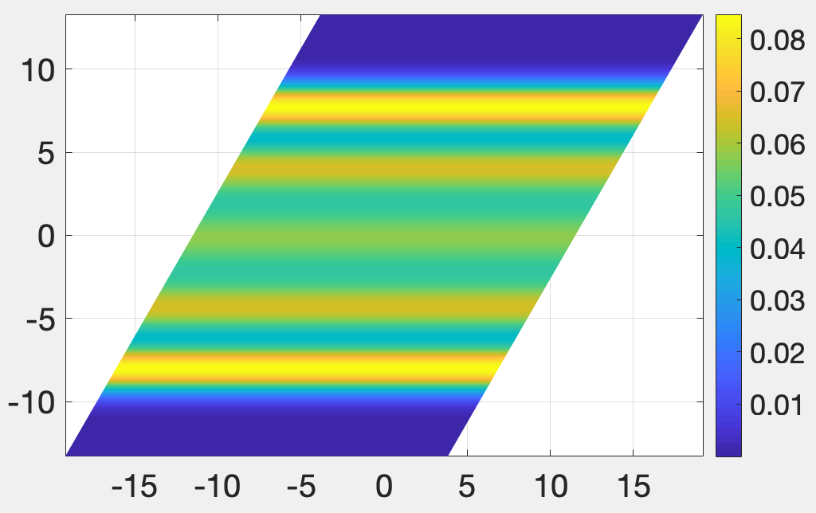
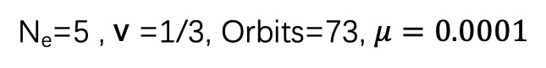
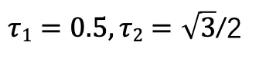
N_{e}=5 , v =1/3, Orbits=73, $μ=0.0001$
parallelogram
Pair correlation function
$τ1=0.5,τ2=\sqrt{3}$/2
Electron density

Slide 2
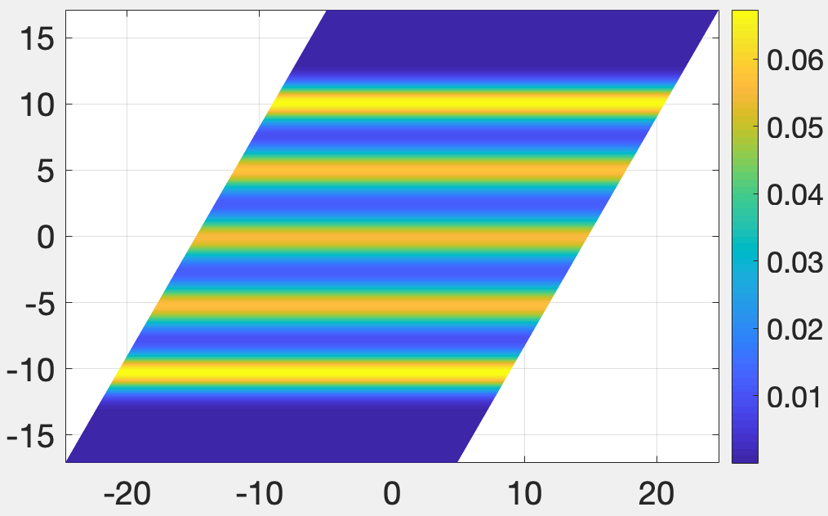
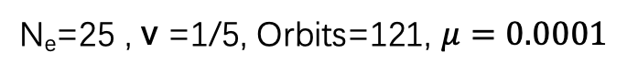
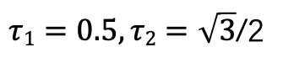
N_{e}=25 , v =1/5, Orbits=121, $μ=0.0001$
parallelogram
Pair correlation function
$τ1=0.5,τ2=\sqrt{3}$/2
Electron density

Slide 3
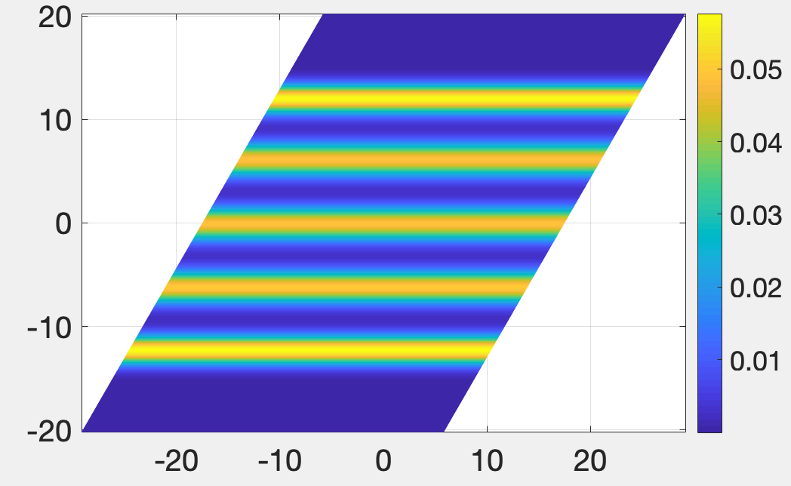
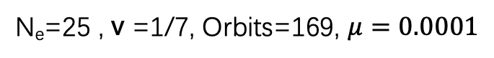
N_{e}=25 , v =1/7, Orbits=169, $μ=0.0001$
parallelogram
Pair correlation function
$τ1=0.5,τ2=\sqrt{3}$/2
Electron density

